Slide 1

Subject: Geography
TOPIC:
NATURAL VEGETATION
AND
WILDLIFE
For Class IX
Prepared by: Showkat Ahmad Ganai
INTRODUCTION
&
KEY TERMS

Slide 2
NATURAL VEGETATION
Vegetation:
                Plant Species
Natural:
              Growing Naturally

Slide 3




Definition
Plant species which grow in association with one another in a particular environmental framework.
Such plant species grow naturally without any human support.

Slide 4

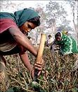


Crops/ Domesticated Plants
Plant species which humans have selected from nature to grow for their use and benefit.
Such plant species have been supported by man at various stages.

Slide 5
Natural Vegetation
+
Crops
Flora
Flora:
All plant species of a geographical area or period of time are together termed as flora.

Slide 6


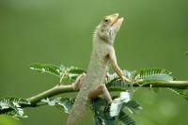

Wildlife
Animal species which live in their natural habitats.
Such animal species are not supported by humans for their growth and development.

Slide 7

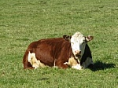
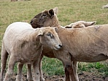
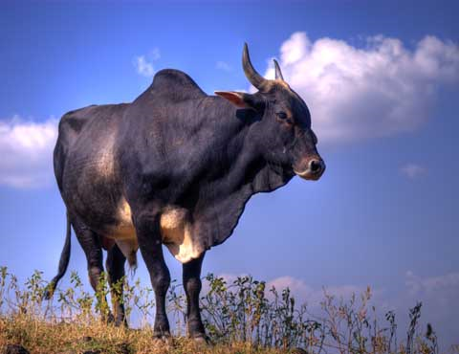
Pets/ Domesticated Animals
Animal species which have been tamed by humans for their own purpose and benefit.
Such animal species are supported by humans at various stages.

Slide 8
+
Wildlife
Pets
Fauna
Fauna:
All animal species of a geographical area are or a period of time together termed as fauna.

Slide 9
Wildlife + Pets Fauna
Natural Vegetation + Crops Flora
Biodiversity

Slide 10
BIODIVERSITY
The wide range of plant and animal species found in a geographical area as a whole is referred to as
Biodiversity.

Slide 11
Interdependence
+
Flora
Fauna
Physical Environment
Range &
Interrelations
Range &
Interrelations
Biodiversity
Ecosystem

Slide 12
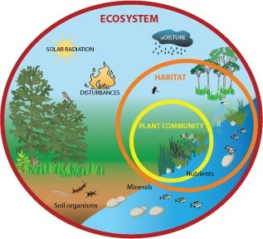
The wide range of plant and animal species, their interrelations and interdependence and their dependence with that of their physical environment forms an Ecosystem

Slide 13
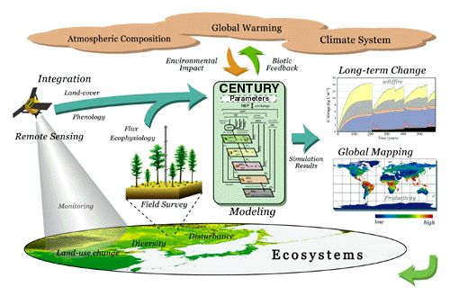
Biome:
A large ecosystem mainly identified on the basis of plant species for the purpose of studies and research is referred to as a biome.

Slide 14
The world ecosystems have been divided in to the following five biomes:
Forest
Savanah
Grasslands
Derserts
Tundra

Slide 15
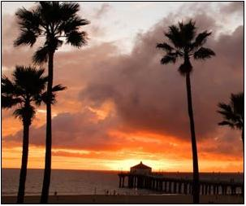
THANK YOU

