Slide 1
FORM AND MOVEMENT IN ANIMALS

Slide 2
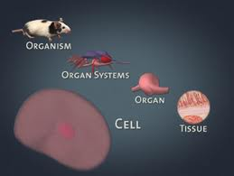
ORGANIZATION OF AN ORGANISM

Slide 3

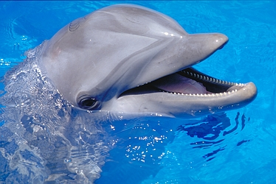

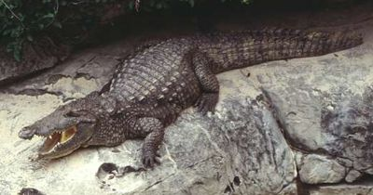

VERTIBRATES

Slide 4
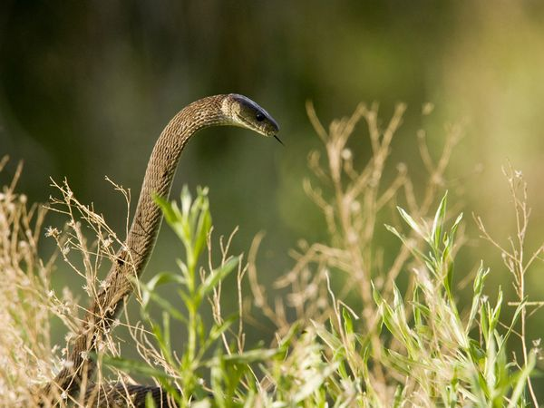
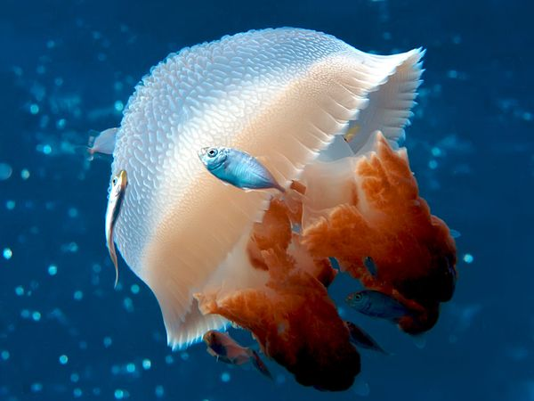
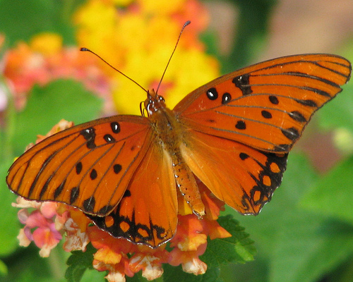

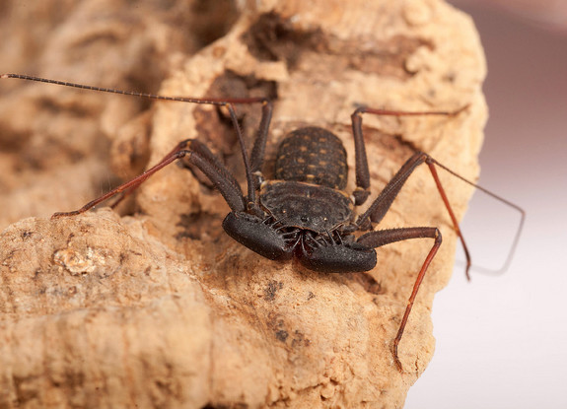
INVERTIBRATES

Slide 5
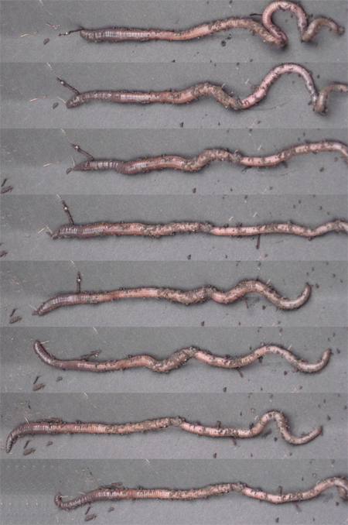
LOCOMOTION IN EARTHWORM

Slide 6
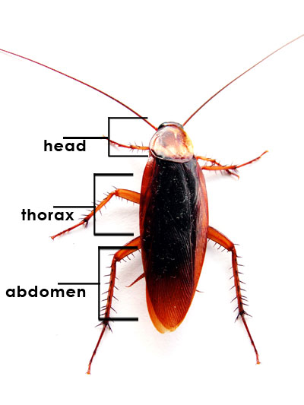
MOVEMENT IN COAKROACH

Slide 7
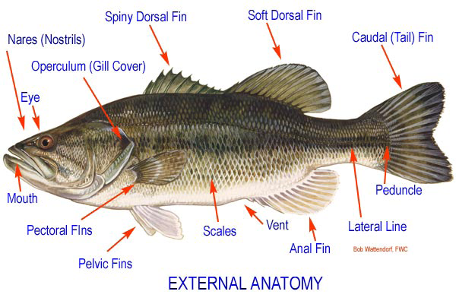
EXTERNAL ANATOMY OF FISH

Slide 8
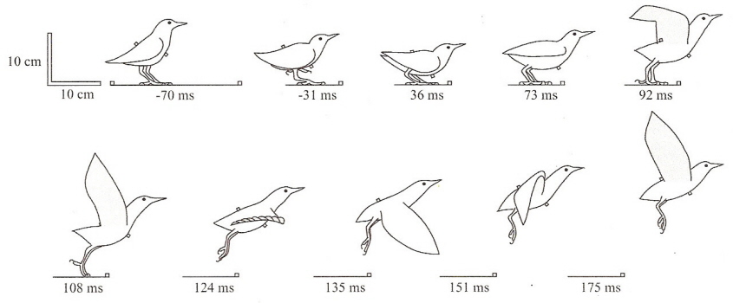
MOVEMENT IN BIRDS

Slide 9
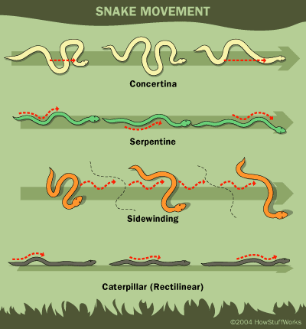
MOVEMENT IN SNAKS

Slide 10
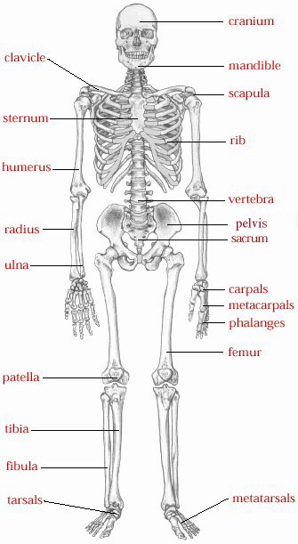
MOVEMENT IN HUMAN BEINGS

Slide 11
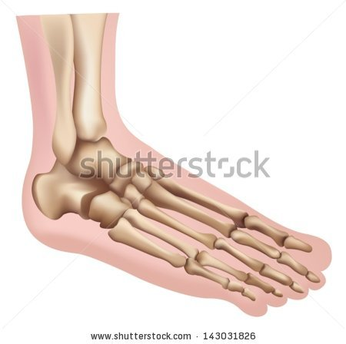

GLIDIDNG JOINT

Slide 12
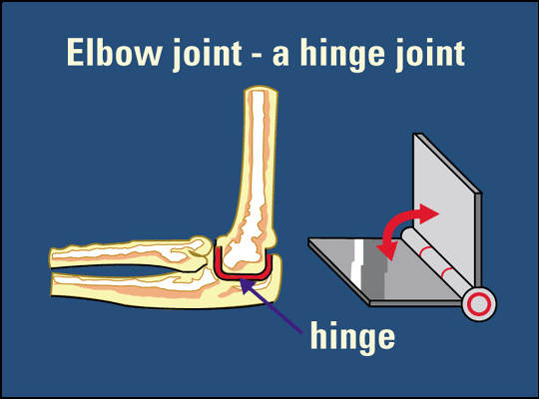
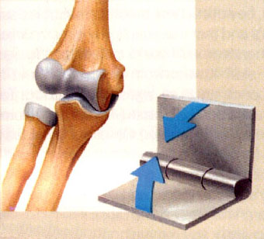
HINGE JOINT

Slide 13
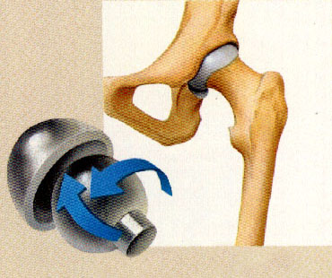
BALL AND SOCKET JOINT

Slide 14
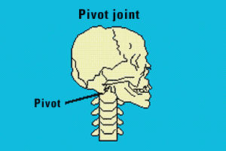
PIVOT JOINT

Slide 15
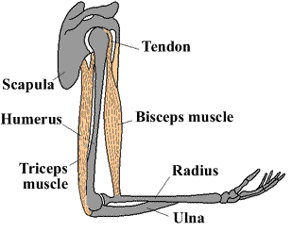
HOW DO BONES MOVES ?
To produce movement at a joint muscles work in pairs. Muscles can only actively contract and shorten. They cannot actively lengthen.
One muscles bends the limb at the joint (flexor) which in the elbow is the biceps. One muscles straightens the limb at the joint (extensor) which in the elbow is the triceps.

Slide 16
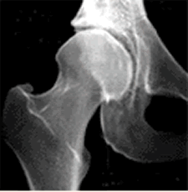
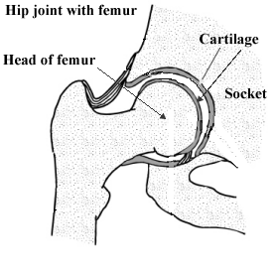
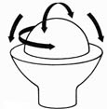
X-RAYS
Rotation is in all planes and axis of movement. The lever is the femur and the fulcrum is the hip joint.

Slide 17

CHEST X-RAY

Slide 18
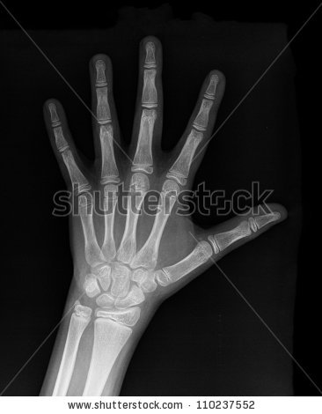
LEFT HAND X-RAY

Slide 19
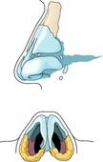
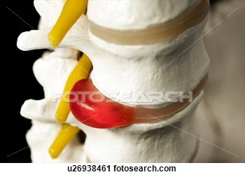
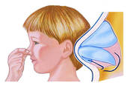
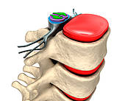
CARTILAGE

