Slide 1
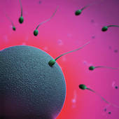

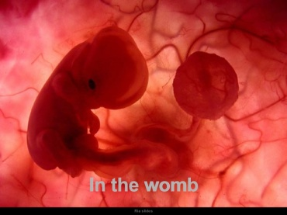
REPRODUCTION

Slide 2
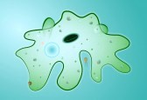
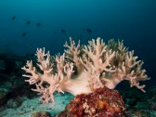
ASEXUAL REPRODUCTION
In asexual reproduction, one individual produces offspring that are genetically identical to itself. These offspring are produced by mitosis. There are many invertebrates, including sea stars and sea anemones for example, that produce by asexual reproduction.

Slide 3
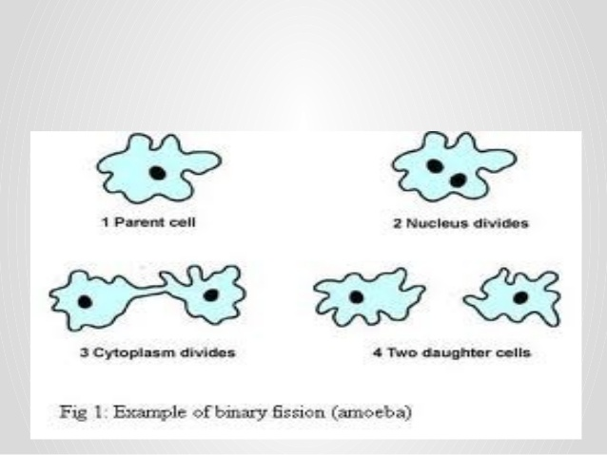
BINARY FISSION

Slide 4
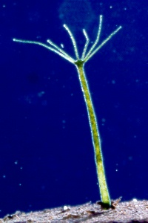
BUDDING
Budding is a form of asexual reproduction in which a new organism develops from an outgrowth or bud on another one. The new organism remains attached as it grows, separating from the parent organism only when it is mature. Since the reproduction is asexual, the newly created organism is a clone and is genetically identical to the parent organism.

Slide 5
SEXUAL REPRODUCTION
The process of sexual reproduction involves two parents. Both parent normally contribute one gamete or sex cell to the process. This process assures that the genetic information given to the offspring will be obtained equally from each parent. The female gamete is called the egg or the ovum and the male gamete is called a sperm. These gametes are formed in specialized reproductive structures called gonads.

Slide 6
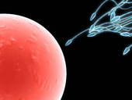
REPRODUCTION IN HUMAN BEINGS
Human sperm entering egg cell

Slide 7
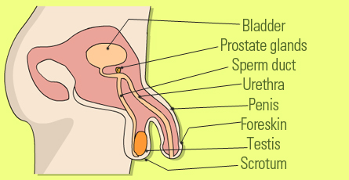
MALE REPRODUCTIVE ORGANS

Slide 8
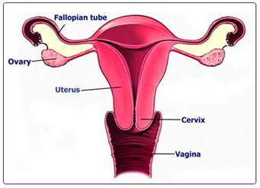
FEMALE REPRODUCTIVE ORGANS

Slide 9
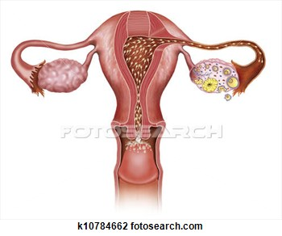
FERTILIZATION
FERTILIZATION

Slide 10
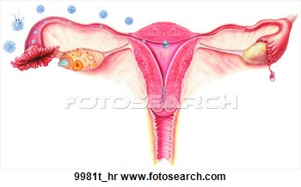
Fertilization And Implantation

Slide 11
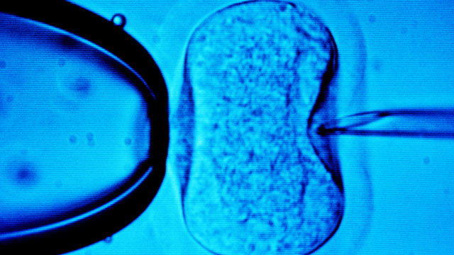
In Vitro Fertilization
In vitro fertilisation (IVF) is a process by which an egg is fertilised by sperm outside the body. IVF is a major treatment for infertility when other methods of assisted reproductive technology have failed. The process involves monitoring a woman's ovulatory process, removing ovum or ova (egg or eggs) from the woman's ovaries and letting sperm fertilise them in a fluid medium in a laboratory. When a woman's natural cycle is monitored to collect a naturally selected ovum (egg) for fertilisation, it is known as natural cycle IVF. The fertilised egg (zygote) is then transferred to the patient's uterus with the intention of establishing a successful pregnancy. The first successful birth of a "test tube baby", Louise Brown, occurred in 1978. Louise Brown was born as a result of natural cycle IVF. Robert G. Edwards, the physiologist who developed the treatment, was awarded the Nobel Prize in Physiology or Medicine in 2010.

Slide 12
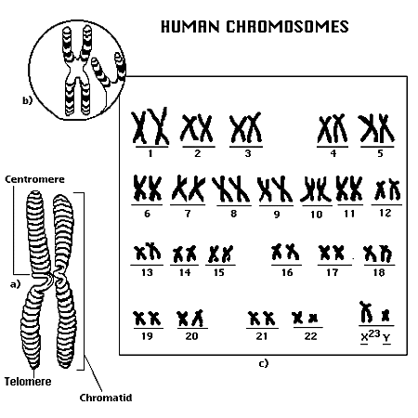
DETERMINATION OF THE SEX OF A BABY
STRUCTURE OF HUMAN CHROMOSOMES

Slide 13
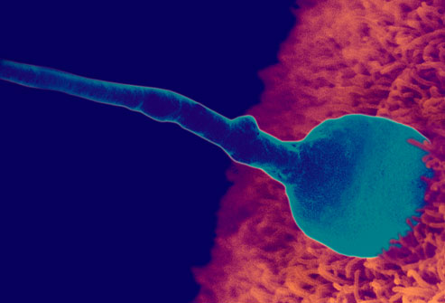
BABY INSIDE THE WOMB
STAGE 1 EGG BEING FERTILIZED BY SPERM

Slide 14
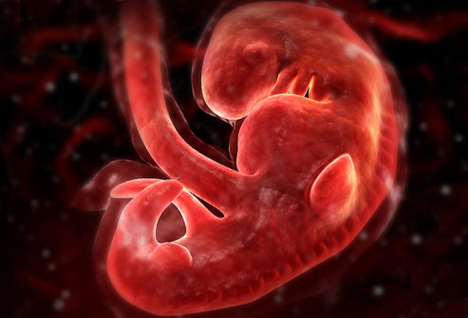
STAGE 2

Slide 15
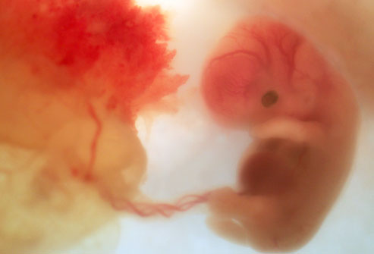
STAGE 3

Slide 16
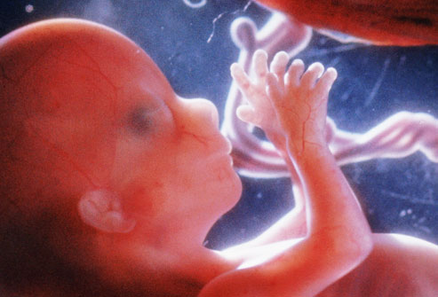
STAGE 4

Slide 17
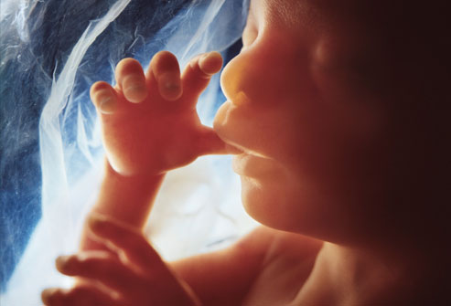
STAGE 5

Slide 18
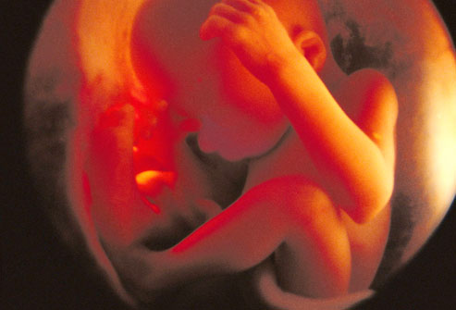
STAGE 6

Slide 19
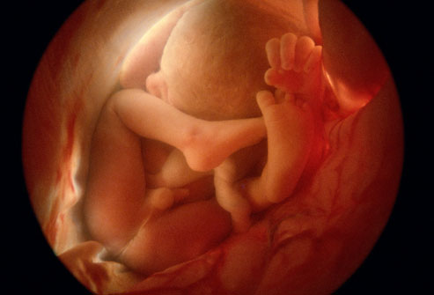
STAGE 7

Slide 20

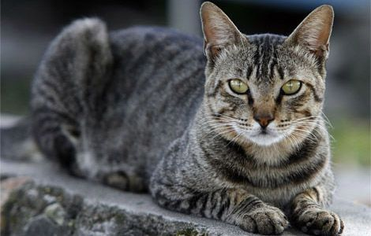
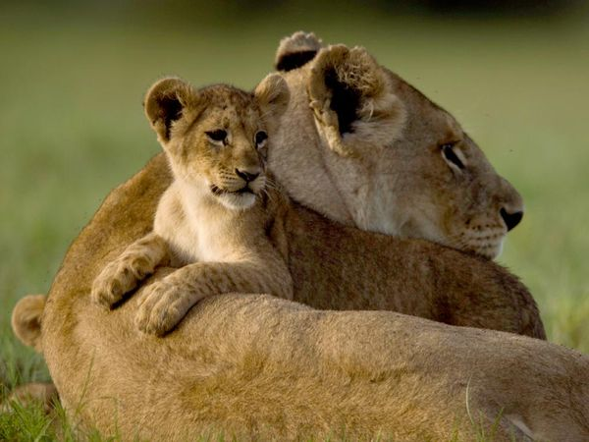
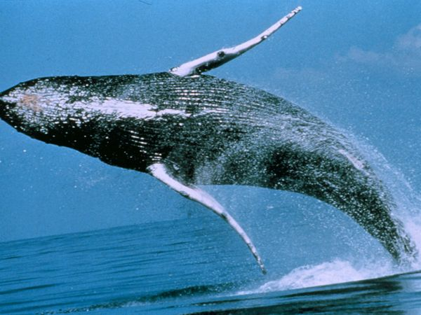
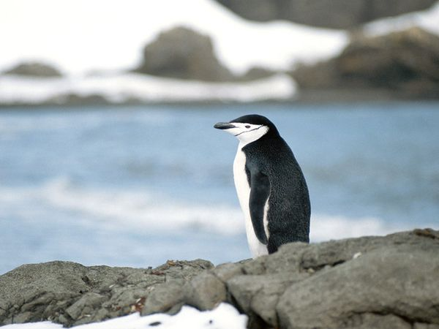
VIVIPAROUS
ANIMALS

Slide 21
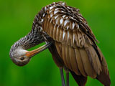
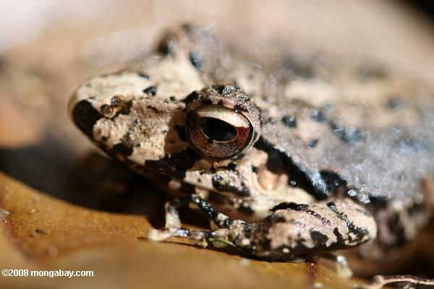
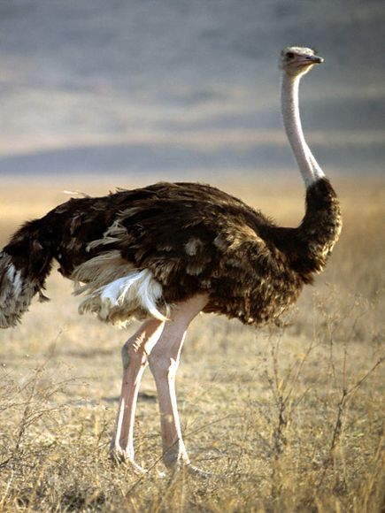
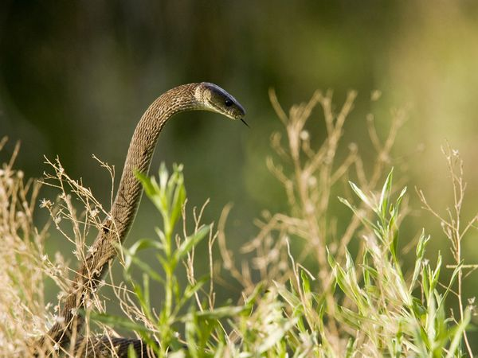
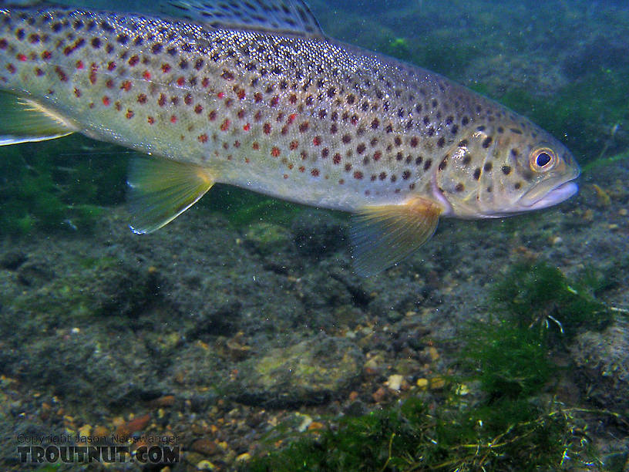
OVIPAROUS ANIMALS

Slide 22
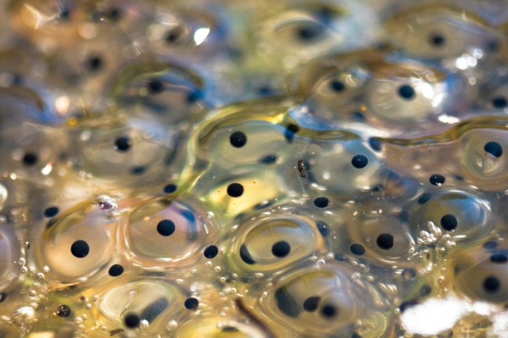
LIFE CYCLE OF A FROG
SPAWN [EGGS]

Slide 23
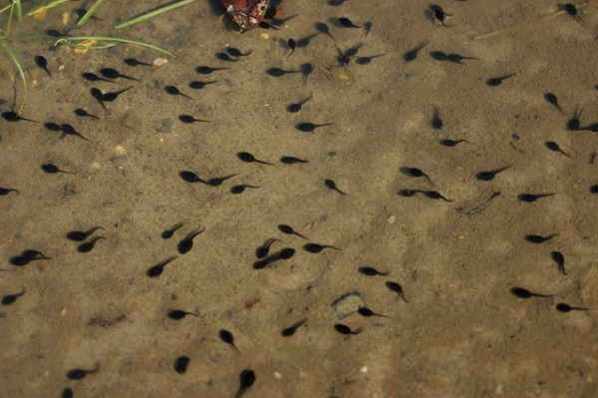
TADPOLES

Slide 24
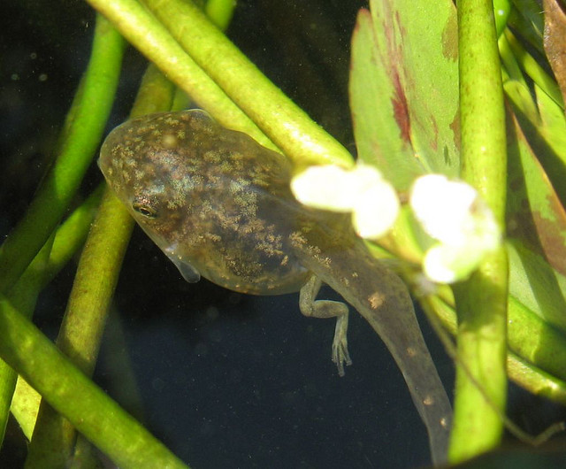
Tadpole with hind legs
TADPOLE WITH HIND LEGS
HIND LEGS

Slide 25
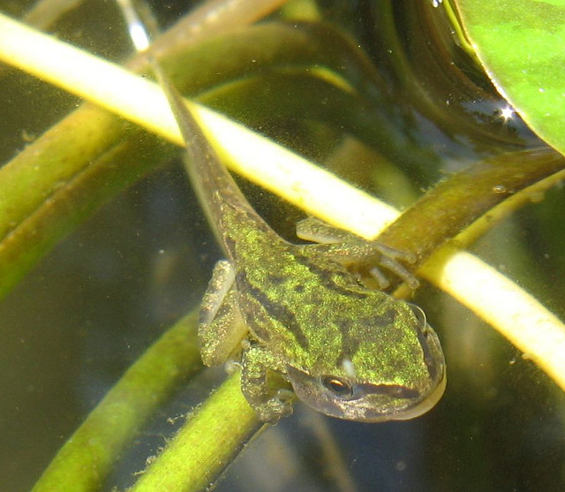
TADPOLE WITH FORE LIMBS AND HIND LIMBS

Slide 26
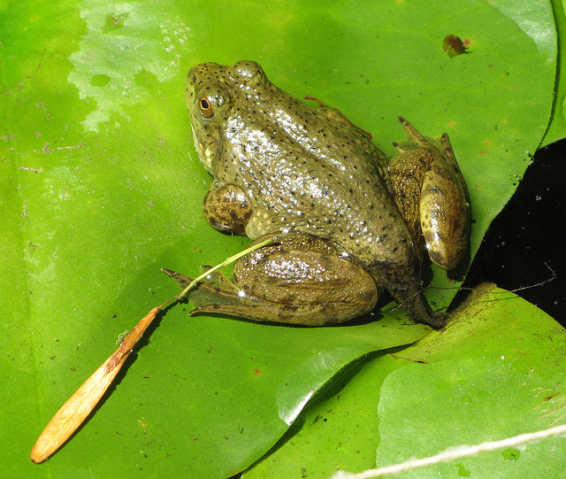
FROGLET

Slide 27
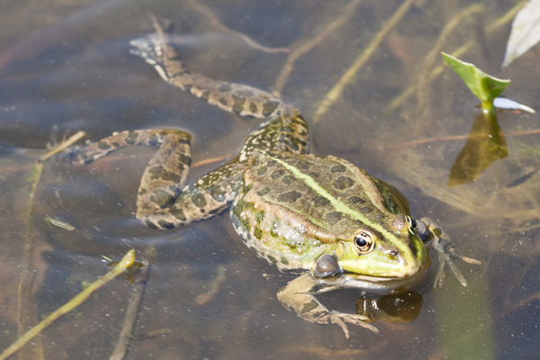
ADULT FROG

Slide 28
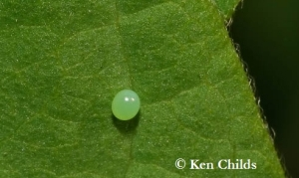
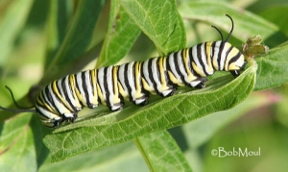
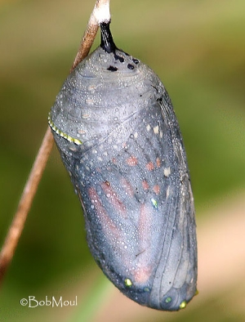
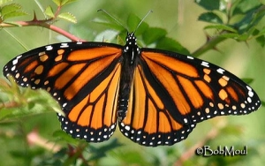
LIFE CYCLE OF A BUTTERFLY

Slide 29

POWERPOINT PRESENTATION FOR CLASS VIII

Slide 30
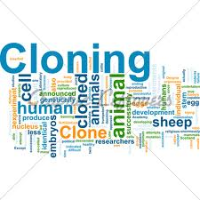

Slide 31
CLASS VIII
TOPIC: REPRODUCTION IN ANIMALS
SUB TOPIC: CLONING

Slide 32
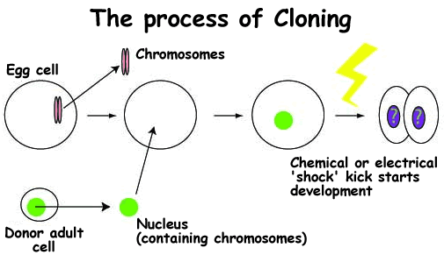
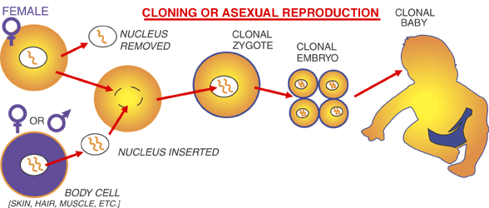
CLONING

Slide 33
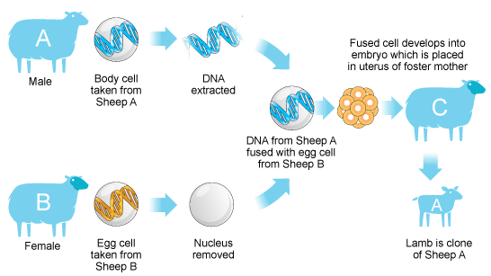
Cloning is the process of creating genetically identical copies of biological matter. This may include genes, cells, tissues or entire organisms. Cloning refers to the development of offspring that are genetically identical to their parent. Animals which reproduce asexually are examples of clones that are produced naturally. Cloning techniques are laboratory processes used to produce offspring that are genetically identical to the donor parent.

Slide 34
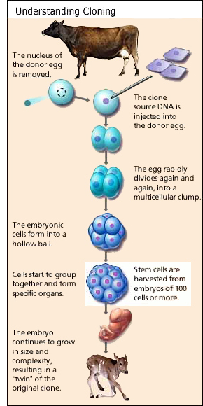
Cloning is done by replacing the nucleus of an egg with the nucleus of another non-reproductive cell. The two fuse together and the egg is activated by a jolt of electricity.

Slide 35
RISKS OF CLONING
  What are the risks of cloning? One of the main concerns as it relates to human cloning is that the current processes used in animal cloning are only successful a very small percentage of the time.
  Another concern is that the cloned animals that do survive tend to have various health problems and shorter life spans. The first step for cloning is extracting small parts of the somatic cells. These are then put into Petri dishes, where more cells replicated. Then, one of these cells are extracted and inserted to a cell that had its own DNA taken out. Then that cell is activated with a short electrical current. It is then cultured until the embryo reaches the blastocyst stage and the uterus is then transferred to the surrogate female.

Slide 36
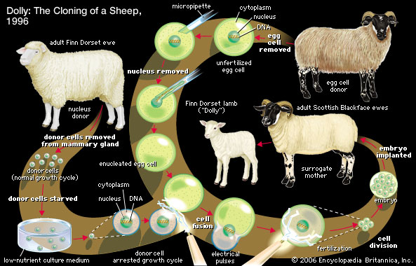

Slide 37
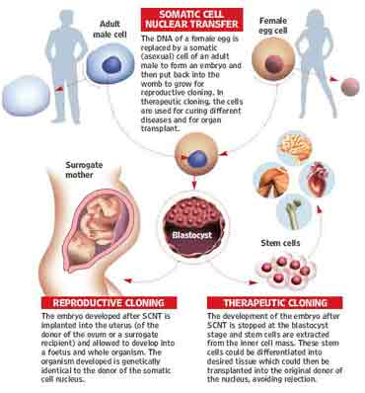

Slide 38
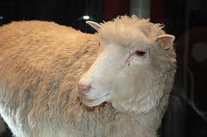
ADULT FINN DORSET EWE

