Slide 1
TRANSPORT OF SUBSTANCES IN ANIMALS AND PLANTS
next

Slide 2
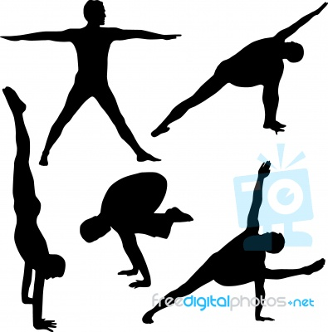
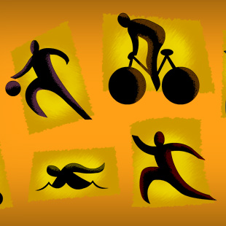
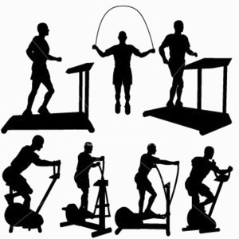
Different physical activities

Slide 3
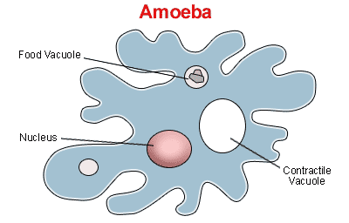
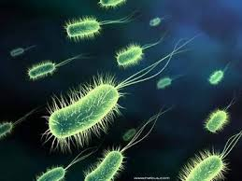
Diffusion in unicellular organisms
All aerobic cells require a source of oxygen, which functions as a terminal electron acceptor in aerobic respiration. When organisms are small, simple diffusion works quickly enough to meet the metabolic demands for oxygen. Thus, many small organisms do not require a complex respiratory system. But because diffusion is a relatively slow process, it cannot meet the oxygen demands of larger organisms.

Slide 4
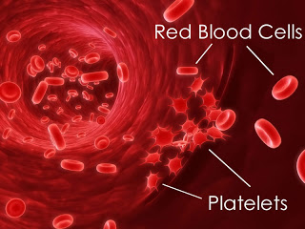
Red blood cells and platelets

Slide 5
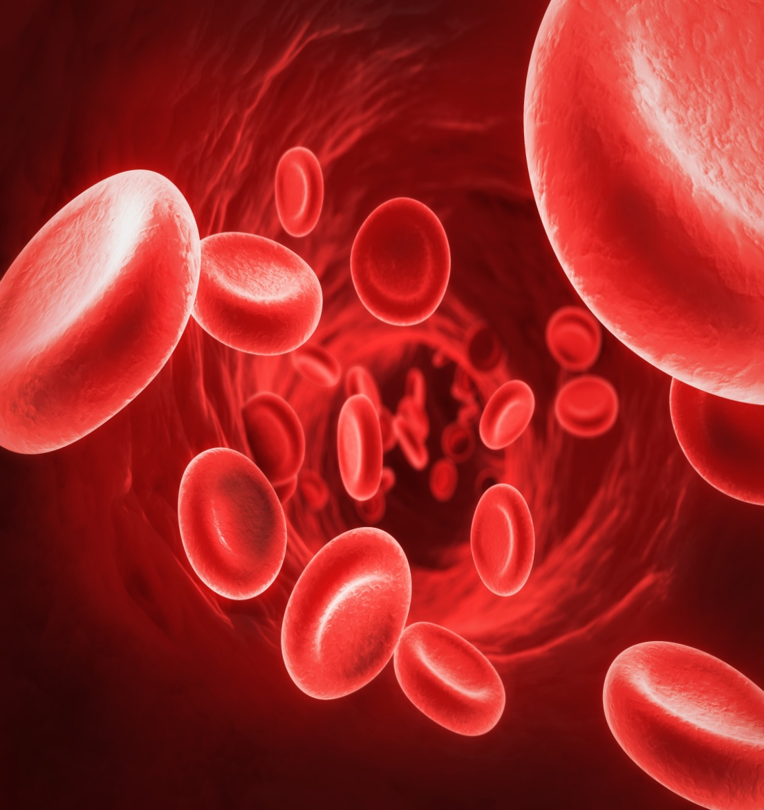
Red blood cells

Slide 6
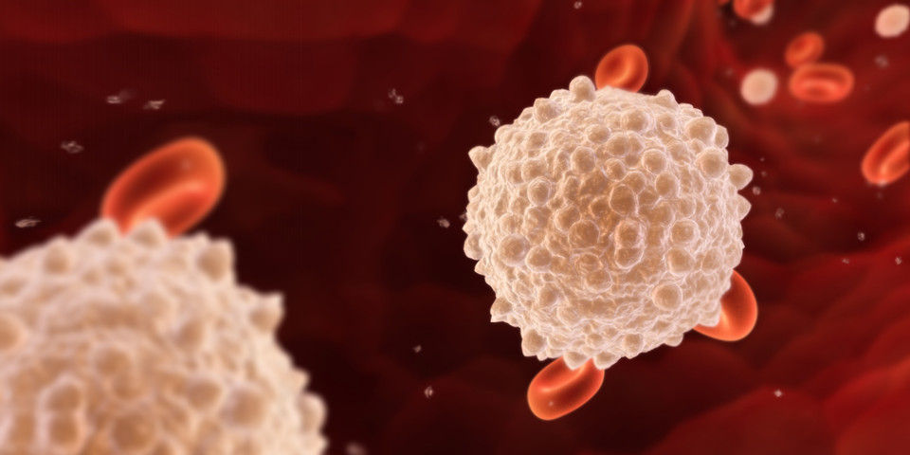
white blood cells

Slide 7
Blood is a specialized body fluid. It has four main components: plasma, red blood cells, white blood cells, and platelets. Blood has many different functions, including:
transporting oxygen and nutrients to the lungs and tissues
forming blood clots to prevent excess blood loss
carrying cells and antibodies that fight infection
bringing waste products to the kidneys and liver, which filter and clean the blood
regulating body temperature
The blood that runs through the veins, arteries, and capillaries is known as whole blood, a mixture of about 55 percent plasma and 45 percent blood cells. About 7 to 8 percent of your total body weight is blood.

Slide 8
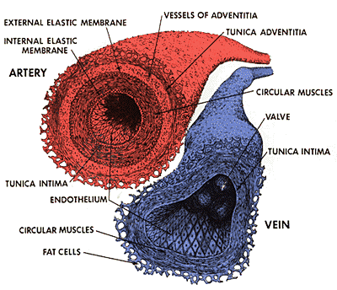
Structure of arteries and veins

Slide 9
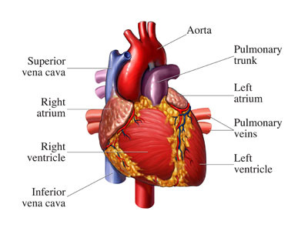
Anatomy of a heart

Slide 10
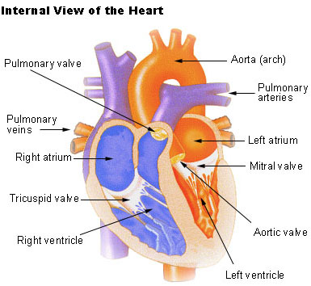
Internal view of the heart

Slide 11
The human heart is a hollow, upside-down, pear-shaped shell. The inside of the heart is divided into four chambers, the left and right atria and the left and right ventricles, which periodically fill with blood and empty. The two atria form the curved top of the heart. The ventricles meet at the bottom of the heart to form a pointed base which points toward the left side of the chest. The left ventricle contracts most forcefully, so the heart beat is felt most strongly on the left side of the chest. A wall, called the septum, separates the right and left sides of the heart. A valve connects each atrium to the ventricle below it. The mitral or bicuspid valve connects the left atrium with the left ventricle.

Slide 12
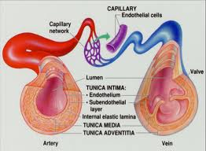
Structure of arteries,veins,capillaires

Slide 13
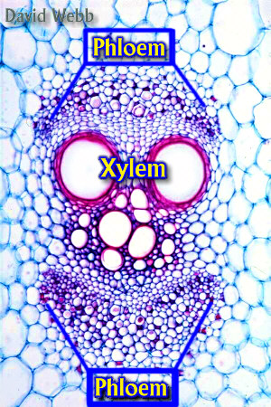
Xylem and phloem

Slide 14
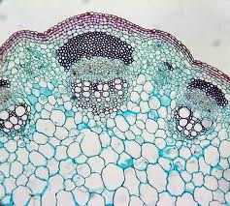
PHLOEM
XYLEM

Slide 15
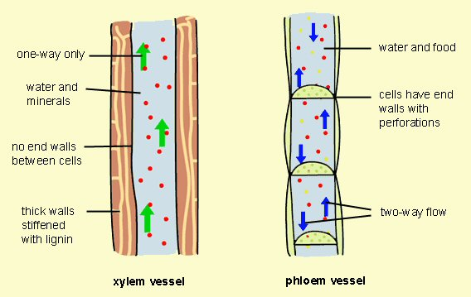

Slide 16
Both xylem and phloem are vascular tissues found in a plant. Xylem is a tubular structure which is responsible for water transport from the roots towards all of the parts of the plant. Phloem is also a tubular structure but is responsible for the transportation of food and other nutrients needed by plant. Xylem imports water and minerals while Phloem transports water and food. Xylem exists as non-living tissue at maturity, but phloem is living cells.

Slide 17
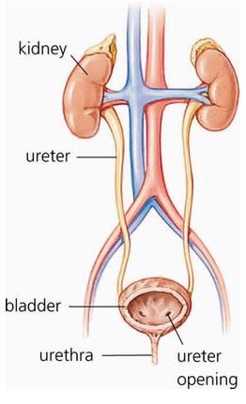
The human excretory system

Slide 18
The human excretory system functions to remove waste from the human body. This system consists of specialized structures and capillary networks that assist in the excretory process. The human excretory system includes the kidney and its functional unit, the nephron. The excretory activity of the kidney is modulated by specialized hormones that regulate the amount of absorption within the nephron.

Slide 19
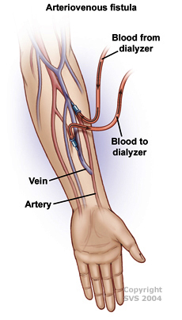
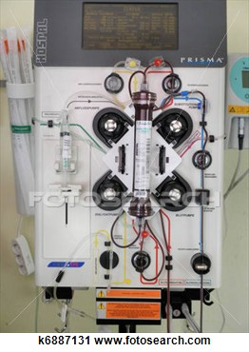
dialysis

Slide 20
Dialysis is the artificial process of eliminating waste (diffusion) and unwanted water (ultra filtration) from the blood. Our kidneys do this naturally. Some people, however, may have failed or damaged kidneys which cannot carry out the function properly - they may need dialysis.

Slide 21
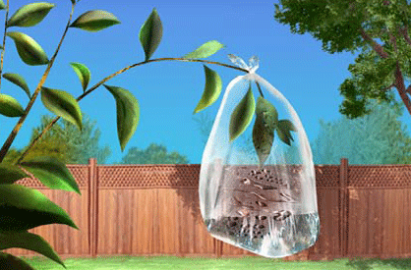
Transpiration can be defined as the process by which water is lost from plants to the atmosphere. It is the evaporation of water from plants and can be thought of as plants "breathing". While you cannot see transpiration taking place in the environment you can measure it by capturing the water loss of a plant inside a plastic bag placed around its leaves.
activity

Slide 22
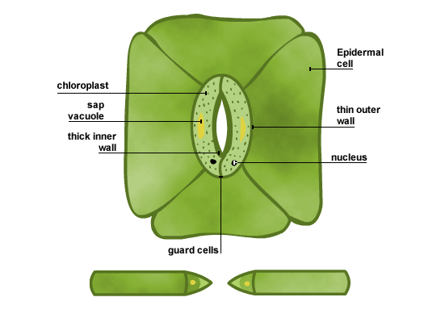
Structure of stomata

Slide 23
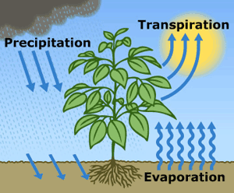
Transpiration (losing of water)

Slide 24
Transpiration is the process of water movement through a plant and its evaporation from aerial parts especially from leaves but also from stems and flowers. Leaf surfaces are dotted with pores which are called stomata, and in most plants they are more numerous on the undersides of the foliage. The stomata are bordered by guard cells and their stomatal accessory cells (together known as stomatal complex) that open and close the pore. Transpiration occurs through the stomatal apertures, and can be thought of as a necessary "cost" associated with the opening of the stomata to allow the diffusion of carbon dioxide gas from the air for photosynthesis. Transpiration also cools plants, changes osmotic pressure of cells, and enables mass flow of mineral nutrients and water from roots to shoots.

Slide 25
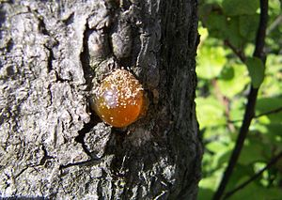
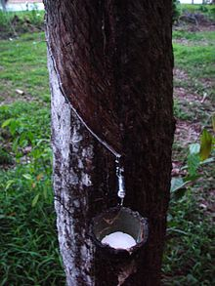
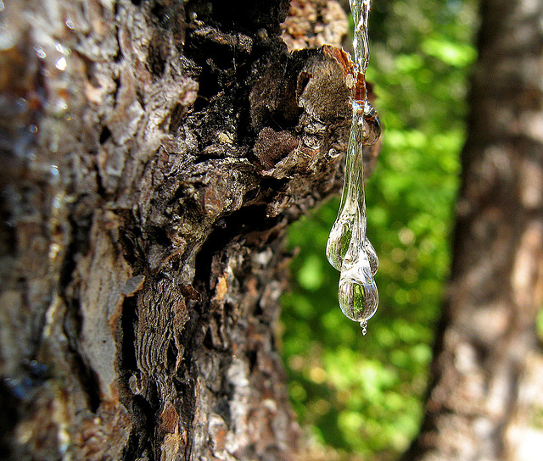
Gum,latex and resins excreted by plants

Slide 26
Resins, latex, rubber and gums are exuded from various parts of the plant body.
In some deciduous plants, the excretory matter is thrown out when the leaves fall.
In some plants, tannin is stored in the bark and woody part of the trunk. Due to this the wood appears dark.
In the different parts of the plant body, crystals of some chemical substances are set aside, for example calcium carbonate crystals in the leaf of fig.

