Slide 1
RESOURCES
AND
DEVELOPMENT
CLASS X (GEOGRAPHY)

Slide 2
GEOGRAPHY: CLASS 10TH
CHAPTER 1: RESOURCE AND DEVELOPMENT
RESOURCE
Definition of a Resource
“Something which can be used to satisfy our needs, is technologically accessible, economically feasible and culturally acceptable is referred as a Resource”.
Physical Environment
Technology Institutions
Human Beings

Slide 3
CLASSIFICATION OF RESOURCES
RESOURCES
Natural
Human
Renewable
Non-Renewable
Structures and Institutions
Quantity and Quality
Continuous or flow
Biological
Recyclable
Non-recyclable
Natural Vegetation
Wildlife

Slide 4
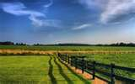
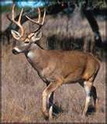
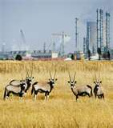
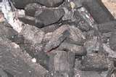
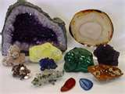
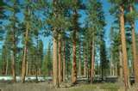
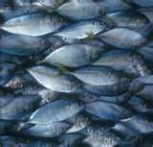
NATURAL RESOURCES
Are those resources which are created by the nature.
Example: land, water, wildlife, atmosphere etc.

Slide 5
Resources have been classified on various basis
1) On the basis of exhaustibility
2) On the basis of origin
3) On the basis of ownership
Renewable resources:
Non-Renewable resources:
Biotic
A biotic resources
Individual resources:
Community resources:
National resources:
International resources:

Slide 6
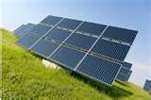
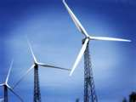
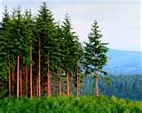
RENEWABLE RESOURCES
Are those resources which can be renewed or recycled or reproduced by physical or chemical processes are known as renewable resources
Example: Forests, Solar energy, Wind energy etc

Slide 7
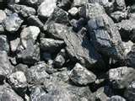
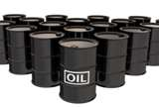
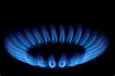
NON – RENEWABLE RESOURCES
Are those resources which take millions of years in their formation and can not be renewed or reproduced are known as renewable resources
Example: Coal, petroleum and natural gas.

Slide 8
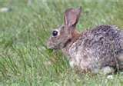
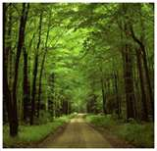
BIOTIC RESOURCES:
These are obtained from biosphere and have life such as human beings, flora and fauna, fisheries, livestock etc.

Slide 9
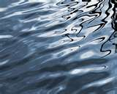
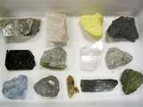

ABIOTIC RESOURCES:
All those things which are composed of non-living things are called a biotic resources. For example, rocks and metals.

Slide 10
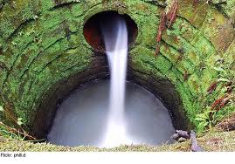
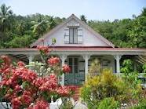

INDIVIDUAL RESOURCES
Are those resources which are operated by an individual or group of individual.
Example: land, pastures, ponds, water in wells etc.
Notes:
RESOURCES OWNED BY PRIVATE INDIVIDUALS

Slide 11
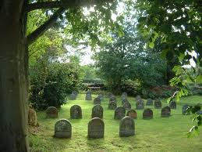
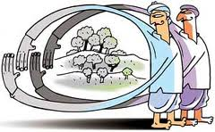
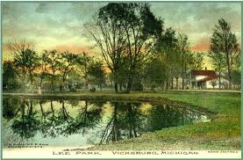
COMMUNITY OWNED RESOURCES
Are those resources which are managed by the all members of the community.
Example: Grazing grounds, burial grounds, public parks, picnic spots etc.

Slide 12
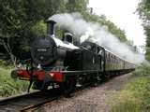
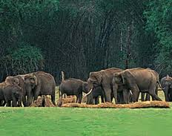
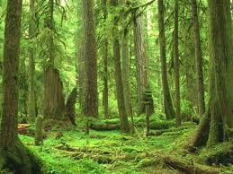
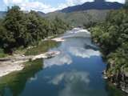
NATIONAL RESOURCES
Are those resources which are related to a particular nation. Land resource are within the political boundaries and oceanic resource up to 12 nautical miles
Example: Minerals, forests, wildlife, oceanic resources etc.

Slide 13
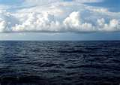
INTERNATIONAL RESOURCES
Are those resources which are managed by international institutions. They belong to various nations of the world.
Example: oceanic resources, petroleum etc.

Slide 14
On the basis of Status of development
Stock resources
Example: Solar and wind energy in Gujarat and Rajasthan
Example: Hydrogen and Oxygen in water
Potential resources
Example: Forests, Water, Minerals etc.
Example: Soil, Aviation
Developed resources
Reserved resources

Slide 15
Potential Resources: Are those resources whose quality and quantity is unknown because of the lack of technology.
Stock resources: Materials in the environment which have the potential to satisfy human needs but human beings do not have the appropriate technology to access these.
Stock resources: Resources which are surveyed and their quality and quantity have been determined for utilization. The development of resources depends on technology and level of their feasibility.
Stock resources: are the subset of the stock, which can be put into use with the help of existing technical ‘know-how’ but their use has not been started. These can be used for meeting future requirements.

Slide 16
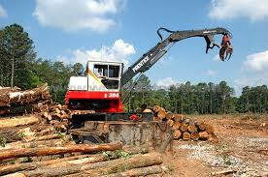
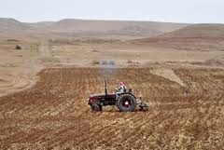
DEVELOPMENT OF RESOURCES
It is the process of developing the resources in order to make them useful for satisfying human wants. Some resources cannot be used directly. They have to be processed to make them useful for satisfying our wants.
Ex: Land has to be cleared and ploughed for growing crops. Water has to be taken to the field to irrigate.

Slide 17
PROBLEMS CREATED BY INDISCRIMINATE USE OF RESOURCE BY MAN
Many resources got depleted. Ex: Forest
b. Resources got accumulated in the hands of few people. The society is divided into rich and poor.
c. Global warming, ozone layer depletion, environmental degradation are other problems.

Slide 18
SUSTAINABLE ECONOMIC DEVELOPMENT
The economic development which does not damage the environment and at the same time takes care of the needs of the future generations is called sustainable development
Sustainable Development is important because:
1) Many of the resources are non-renewable and exhaustible. Over exploitation of these resources will affect the needs of our future generations.
2) Environmental pollution has become a major threat to the survival of human beings

Slide 19
RESOURCE PLANNING
Resource planning is a technique or skill of proper utilization of resources.
STAGES OF RESOURCE PLANNING
a) IDENTIFICATION AND LISTING OF RESOURCES
Surveying, mapping and the measurement of the qualities and the quantities of the resources are the important activities undertaken at this stage.
b) PLANNING FOR EXPLOITATION
Develop a planning structure with suitable technology, skill and institutional setup.
c) MATCH RESOURCE DEVELOPMENT PLANS WITH NATIONAL DEVELOPMENT PLANS.

Slide 20
IMPORTANCE OF RESOURCE PLANNING
It is necessary for the balanced development of India.
1) Some regions of India are rich in certain resources and poor in some other resources.
Ex: Rajasthan is poor in water resources but rich in solar and wind energy.
2) Some regions are self sufficient while other regions are very poor in important resources. Ex: Madhya Pradesh is rich in many resources but Ladakh is poor in resources.
3) Wastage of resources can be avoided by planning.
4) Environmental pollution can be reduced.
5) Over exploitation of resources can be avoided.

Slide 21
RESOURCE CONSERVATION
Planned use of resources in order to meet the present needs and to store a part for the future generations is called resource conservation.
It is necessary because
1) Many resources are non-renewable and exhaustible. If we conserve them we can use them for a longer period of time.
2) Conservation of resources helps us to reduce wastage. It will help in economic progress.
3) Resource conservation helps us to protect the environment.

Slide 22
IDEAS OF GANDHIJI ABOUT THE CONSERVATION OF RESOURCES.
According to Gandhiji, “There is enough for everybody’s need and not for anybody’s greed.
Greedy and selfish individuals and the exploitative nature of modern technology are the root cause for resource depletion.
He was against mass production and wanted to replace it with production by masses.

