Slide 1


Slide 2
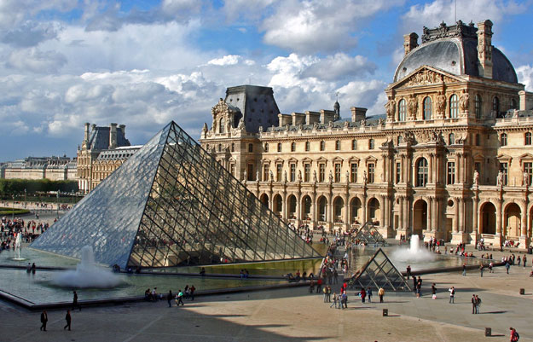

Slide 3
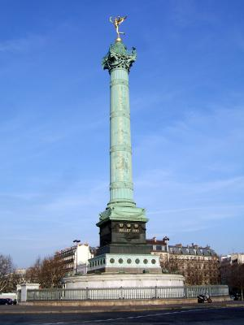

Slide 4
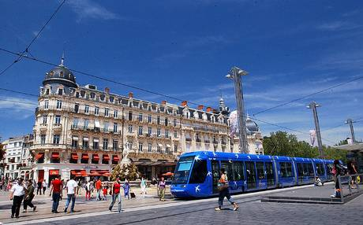

Slide 5
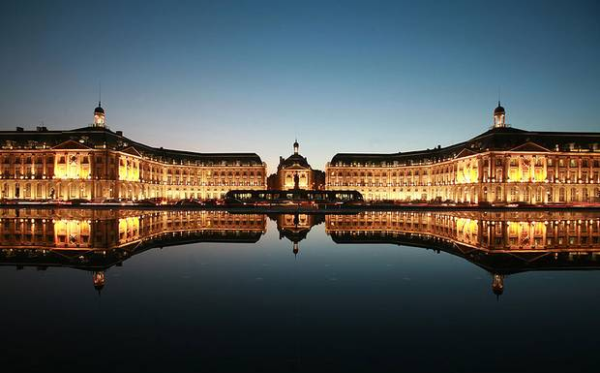

Slide 6
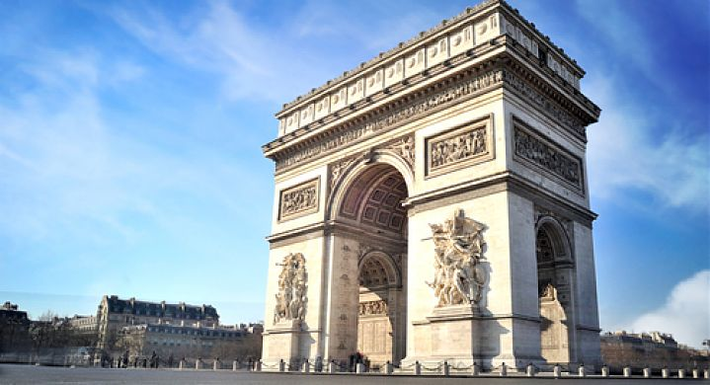

Slide 7
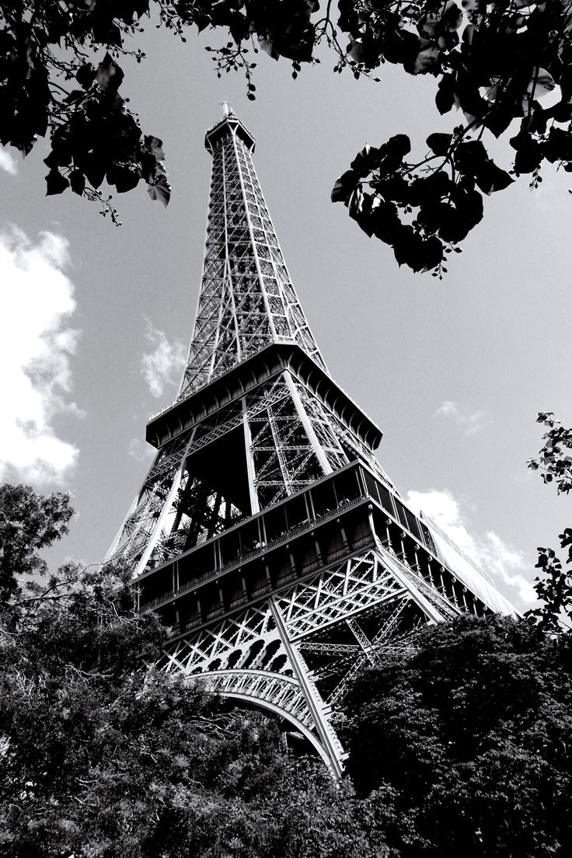

Slide 8
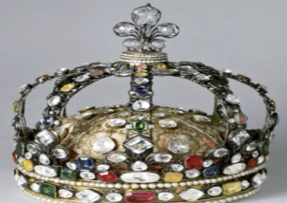

  History
  Chapter: 01

Slide 9

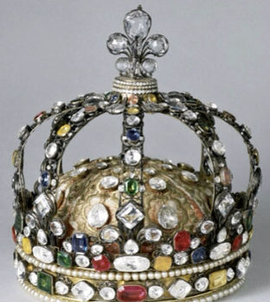

French
Revolution
14th July, 1789
By: Muzaffar Ahmad Bhat

Slide 10

Europe
North America
France
Southh America
Asia
Africa
Antartica
Australia

Slide 11

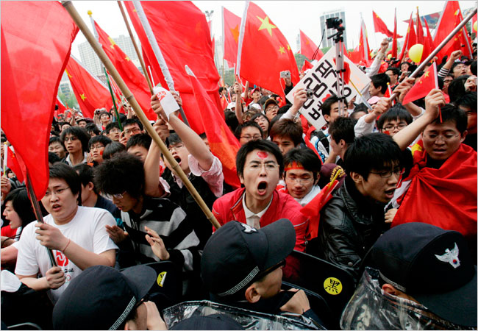
  Revolution
  A recognised momentous change in any situation.
  A revolution may result in sudden overthrow of an established govt or system by force and bloodshed, e.g., French Revolution.
  It can also be a great change that comes slowly and peacefully, e.g., Industrial Revolution.

Slide 12
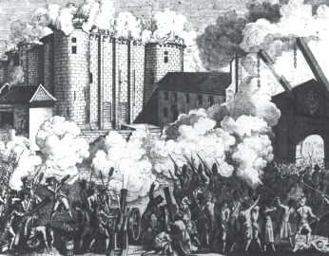
French Revolution
French Revolution was the mass uprising of the people of France against the dictatorial and anti-people policies of the monarch.
It started on 14th July 1789 with an incident known as Storming of Bastille.

Slide 13
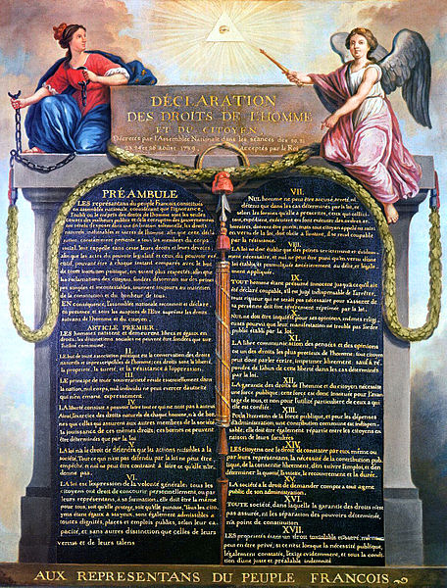
I
N
T
R
O
D
U
C
T
I
O
N
Today we often take the ideas of liberty, freedom and equality for granted.
But we need to remind ourselves that these ideas also have a history.
This history can find its origin in French Revolution.
It led to the end of monarchy, end of society based on privileges and gave way to a new system of governance.
It declared the idea that all individuals had rights and could claim equality.
These notions of equality and freedom emerged as the central ideas of a new age.

Slide 14
UPCOMING TOPICS
Causes
Events
Consequences

Slide 15
CAUSES
CAUSES
CAUSES
CAUSES
CAUSES

Slide 16
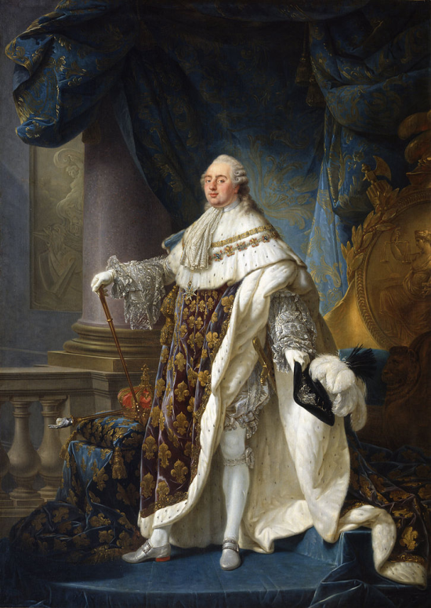
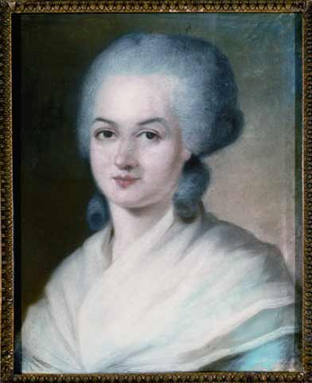
Political Condition in France
In 1774, Louis XVI of the Bourbon family of kings ascended the throne of France.
He was 20 years old and married to the Austrian princess Marie Antoinette.
He ruled as an absolute monarch and believed in divine powers of king.
He was pleasure loving and extravagant.

Slide 17
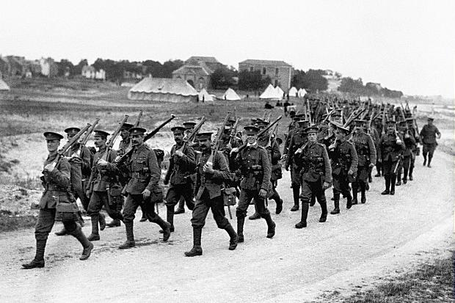
He had maintained a huge army and built a big extravagant court at the immense palace of Versailles.
Louis XVI was devoted to his wife who constantly interfered with the administration.
Common people had no say in the affairs of the government.
All bureaucratic posts were occupied by the aristocrats and from the family of kings.

Slide 18
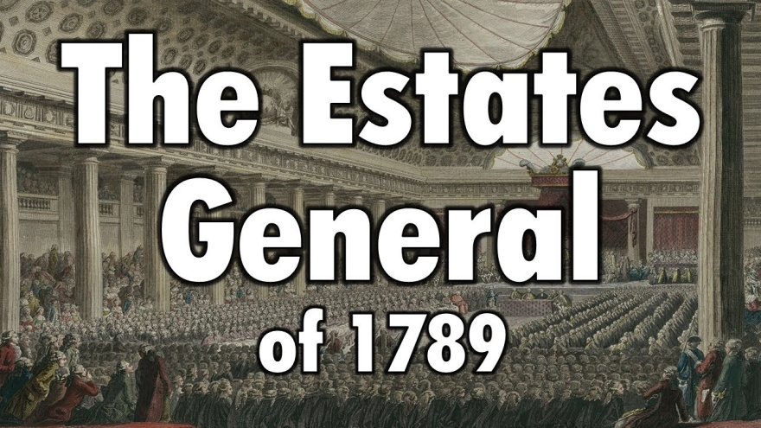
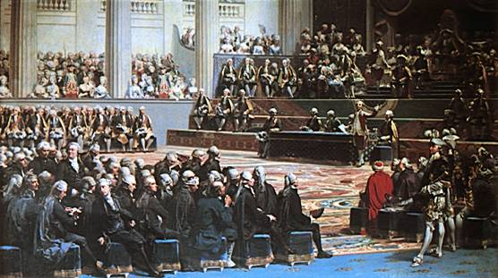
There was a political body, known as Estate General to which three estates sent their representatives to discuss contemporary issues.
However, the monarch alone could decide when to call a meeting of this body. The last time it was done was in 1614.
Each estate had one vote, irrespective of the number of representatives.
The Estate General had power to increase the taxes.

Slide 19
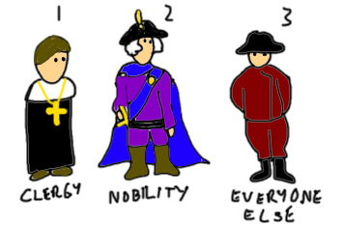
French Society
French society in the eighteenth century was divided into three estates or Classes.
The society of estates was part of the feudal system that dated back to the middle ages. The term Old Regime is usually used to describe the society and institutions of France before 1789.

Slide 20
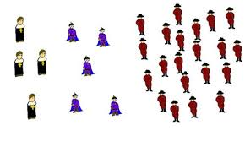
The first estate comprised of clergy, second of king and his family and third of common people.
Peasants made up about 90 per cent of the population.
However, only a small number of them owned the land they cultivated.
About 60 per cent of the land was owned by nobles, the Church and other richer members of the third estate.

Slide 21
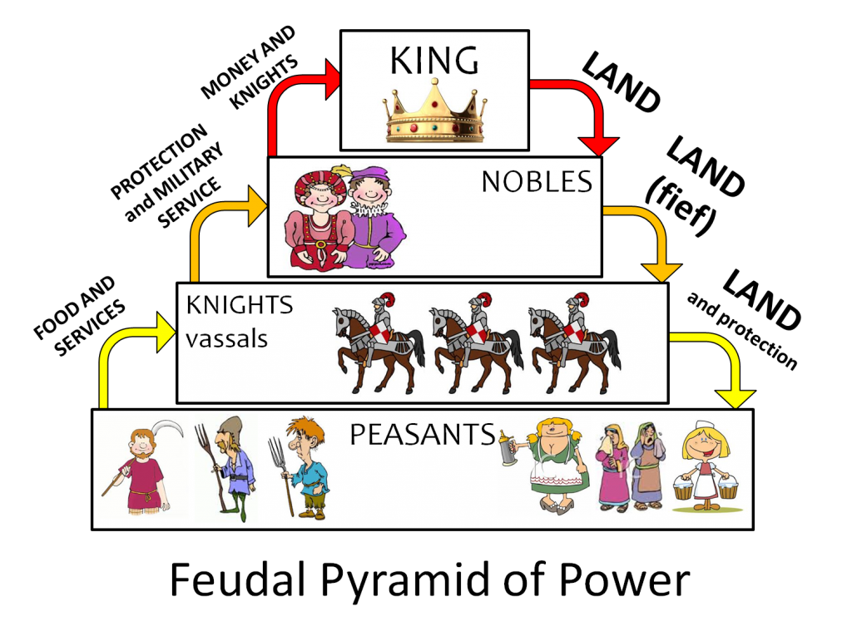
Which they leased to peasants for huge share in the production.
Peasants were obliged to render services to the lord – to work in his house and fields – to serve in the army or to participate in building roads.
The members of the first two estates, that is, the clergy and the nobility, enjoyed certain privileges by birth.

Slide 22
French Economy
French economy was struggling under Louis XVI.
It was still based on serfdom and feudal system.
The government charged huge taxes from third estate.
These included a direct tax, called Taille, and a number of indirect taxes which were levied on articles of everyday consumption like salt or tobacco.

Slide 23
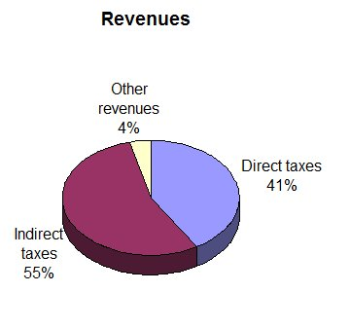
The burden of financing activities of the state through taxes was borne by the third estate alone.
First two estates were exempted from paying taxes to the state.
The Church too extracted its share of taxes called tithes from the peasants, and finally.
Louis XVI drove France into useless wars bringing the country to the verge of bankruptcy.

Slide 24
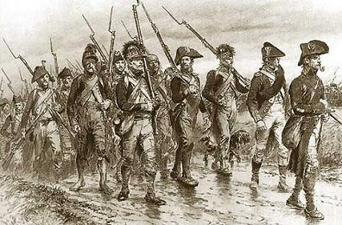
France was always at war with its conventional rival Britain.
Under Louis XVI, France helped the thirteen American colonies to gain their independence from the common enemy, Britain.
The war added more than a billion livres to a debt that had already risen to more than 2 billion livres.
Lenders, who gave the state credit, now began to charge 10 per cent interest on loans.

Slide 25
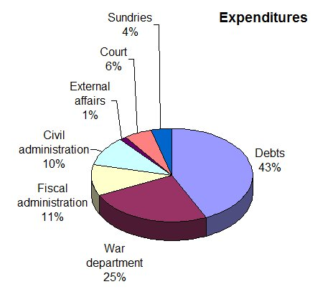
So the French government was obliged to spend an increasing percentage of its budget on interest payments alone.
To meet its regular expenses, such as the cost of maintaining an army, the court, running government offices or universities, the state was forced to increase taxes.

Slide 26
GROWING MIDDLE CLASS
The eighteenth century witnessed the emergence of social groups, termed the middle class, who earned their wealth through an expanding overseas trade.
The third estate included professions such as lawyers or administrative officials.
All of these were educated and believed that no group in society should be privileged by birth.

Slide 27
Rather, a person’s social position must depend on his merit.
These ideas demanded a society based on freedom and equal laws and opportunities for all.

Slide 28
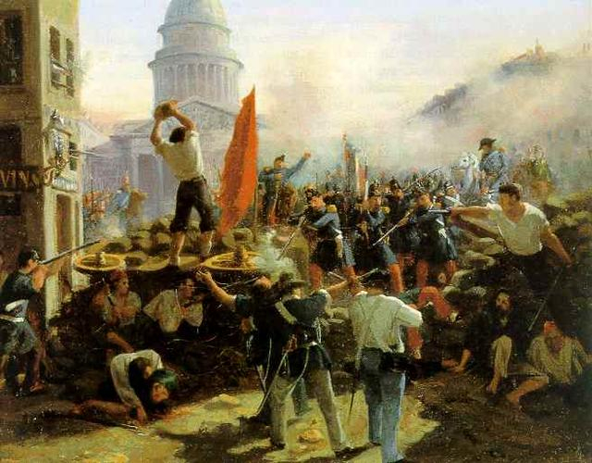
Subsistence crisis
An extreme situation where the basic means of livelihood are endangered
The population of France rose from about 23 million in 1715 to 28 million in 1789.
This led to a rapid increase in the demand for foodgrains.
Production of grains could not keep pace with the demand. So the price of bread which was the staple diet of the majority rose rapidly.

Slide 29
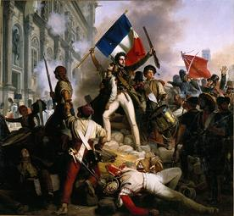
Most workers were employed as laborers in workshops whose owner fixed their wages.
But wages did not keep pace with the rise in prices. So the gap between the poor and the rich widened.
Things became worse whenever drought or hail reduced the harvest.
This led to a subsistence crisis, something that occurred frequently in France during the Old Regime.

Slide 30
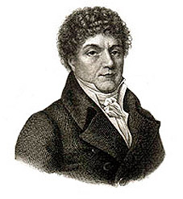
French philosophers
The ideas envisaging a society based on freedom and equal laws and opportunities for all, were put forward by philosophers such as John Locke and Jean Jacques Rousseau.
In his Two Treatises of Government, Locke sought to refute the doctrine of the divine and absolute right of the monarch.

Slide 31
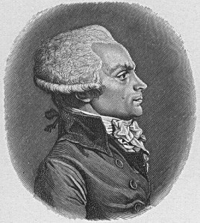
Rousseau carried the idea forward, proposing a form of government based on a social contract between people and their representatives.
In The Spirit of the Laws, Montesquieu proposed a division of power within the government between the legislative, the executive and the judiciary.
This model of government was put into force in the United States of America.
The ideas of these philosophers were discussed intensively

Slide 32
events
eventS
events
events
eventS

Slide 33
Increase in Taxes
Louis XVI had to increase taxes for reasons you have learnt in the previous section.
How do you think he could have gone about doing this?
In France of the Old Regime the monarch did not have the power to impose taxes according to his will alone.

Slide 34
Rather he had to call a meeting of the Estates General which would then pass his proposals for new taxes.
The last time it was done was in 1614. Some 200 years back.

Slide 35
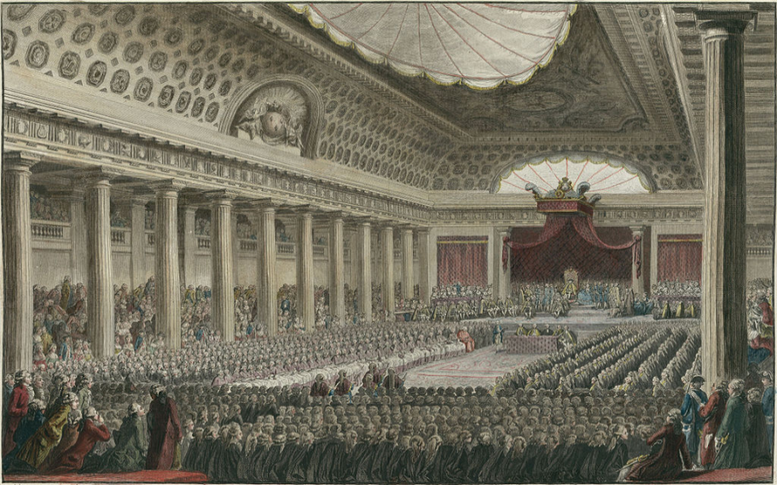
Session of estates General
On 5 May 1789, Louis XVI called together an assembly of the Estates General to pass proposals for new taxes.
A resplendent hall in Versailles was prepared to host the delegates.
The first and second estates sent 300 representatives each, who were seated in rows facing each other on two sides, while the 600 members of the third estate had to stand at the back.

Slide 36
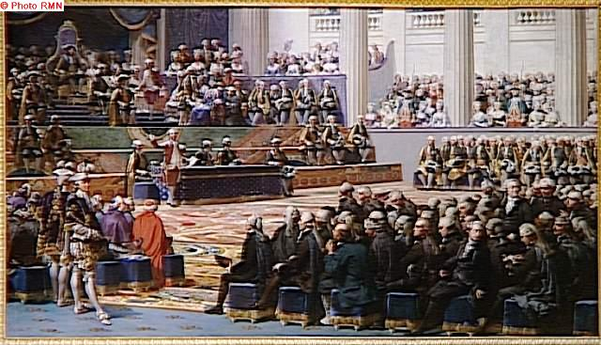
The third estate was represented by its more prosperous and educated members.
Peasants, artisans and women were denied entry to the assembly.
However, their grievances and demands were listed in some 40,000 letters which the representatives had brought with them.

Slide 37
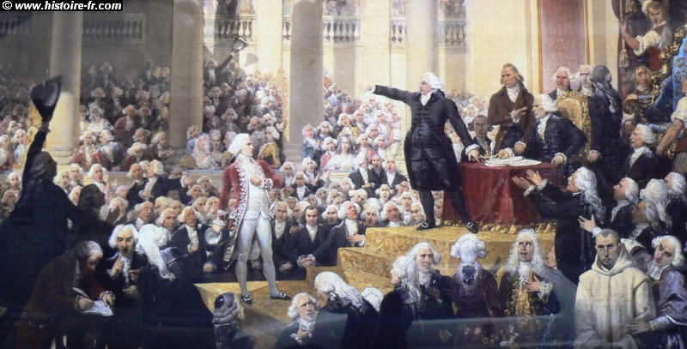
Voting in the Estates General in the past had been conducted according to the principle that each estate had one vote.
This time too Louis XVI was determined to continue the same practice.
But members of the third estate demanded that voting now be conducted by the assembly as a whole, where each member would have one vote.

Slide 38
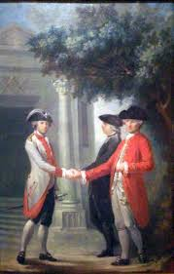
This was one of the democratic principles put forward by philosophers like Rousseau in his book The Social Contract.
When the king rejected this proposal, members of the third estate walked out of the assembly in protest.

Slide 39
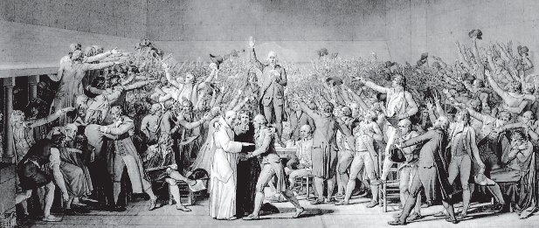
Formation of national assembly
The representatives of the third estate viewed themselves as spokesmen for the whole French nation.
On 20 June they assembled in the hall of an indoor tennis court in the grounds of Versailles.
They declared themselves a National Assembly and swore not to disperse till they had drafted a constitution for France that would limit the powers of the monarch.

Slide 40
They were led by Mirabeau and Abbé Sieyès.
Mirabeau was born in a noble family but was convinced of the need to do away with a society of feudal privilege.
He brought out a journal and delivered powerful speeches to the crowds assembled at Versailles.
Abbé Sieyès, originally a priest, wrote an influential pamphlet called ‘What is the Third Estate’?

Slide 41
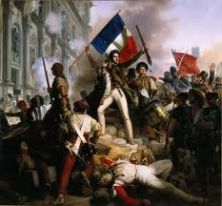
Outbreak of
revolution
While the National Assembly was busy at Versailles drafting a constitution, the rest of France seethed with turmoil.
A severe winter had meant a bad harvest; the price of bread rose, often bakers exploited the situation and hoarded supplies.
After spending hours in long queues at the bakery, crowds of angry women stormed into the shops.

Slide 42
On the morning of 14 July 1789, the city of Paris was in a state of alarm.
The king had commanded troops to move into the city.
Rumours spread that he would soon order the army to open fire upon the citizens.
Some 7,000 men and women gathered in front of the town hall and decided to form a peoples’ militia.

Slide 43
They broke into a number of government buildings in search of arms.
Finally, a group of several hundred people marched towards the eastern part of the city and stormed the fortress-prison, the Bastille, where they hoped to find hoarded ammunition.

Slide 44
The fortress was demolished and its stone fragments were sold in the markets to all those who wished to keep a souvenir of its destruction.
Meanwhile, in the countryside too there were riots and attacks on nobles.
Nobles were forced to flee the country.

Slide 45
Constitutional Monarchy
In a mean time national assembly had prepared a draft of constitution that would limit the powers of king.
Faced with the power of his revolting subjects, Louis XVI finally accorded recognition to the National Assembly and accepted the principle that his powers would from now on be checked by a constitution.

Slide 46
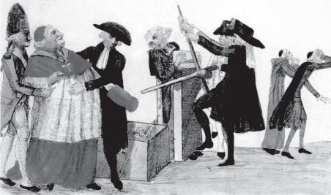
On the night of 4 August 1789, the Assembly passed a decree abolishing the feudal system of obligations and taxes.
Members of the clergy too were forced to give up their privileges.
Tithes were abolished and lands owned by the Church were confiscated.
As a result, the government acquired assets worth at least 2 billion livres.

Slide 47
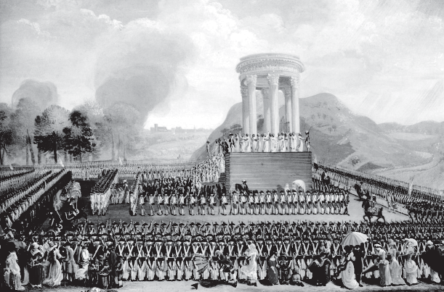
Features of new constitution
The National Assembly completed the draft of the constitution in 1791.
Its main object was to limit the powers of the monarch.
These powers instead of being concentrated in the hands of one person, were now separated and assigned to different institutions – the legislature, executive and judiciary. This made France a constitutional monarchy.

Slide 48
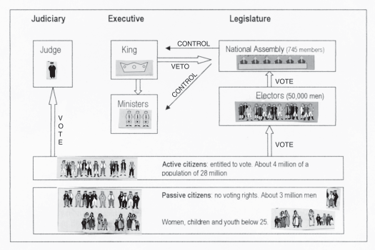
The Constitution of 1791 vested the power to make laws in the National Assembly, which was indirectly elected i.e., citizens voted for a group of electors, who in turn chose the Assembly.
However, not all citizens had the right to vote.
Only men above 25 years of age who paid taxes equal to at least 3 days of a labourer’s wage were given the status of active citizens, that is, they were entitled to vote.

Slide 49
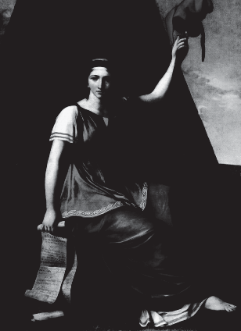
The remaining men and all women were classed as passive citizens.
To qualify as an elector and then as a member of the Assembly, a man had to belong to the highest bracket of taxpayers.
The Constitution began with a Declaration of the Rights of Man and Citizen.

Slide 50
Rights such as the right to life, freedom of speech, freedom of opinion, equality before law, were established as ‘natural and inalienable’ rights, that is, they belonged to each human being by birth and could not be taken away.
It was made the duty of the state to protect each citizen’s natural rights.

Slide 51
The Declaration of Rights of Man and Citizen
Men are born and remain free and equal in rights.
The aim of every political association is the preservation of the natural and inalienable rights of man; these are liberty, property, security and resistance to oppression.
The source of all sovereignty resides in the nation; no group or individual may exercise authority that does not come from the people.

Slide 52

Liberty consists of the power to do whatever is not injurious to others.
The law has the right to forbid only actions that are injurious to society.
Law is the expression of the general will.
All citizens have the right to participate in its formation, personally or through their representatives.
All citizens are equal before it.
No man may be accused, arrested or detained, except in cases determined by the law.

Slide 53
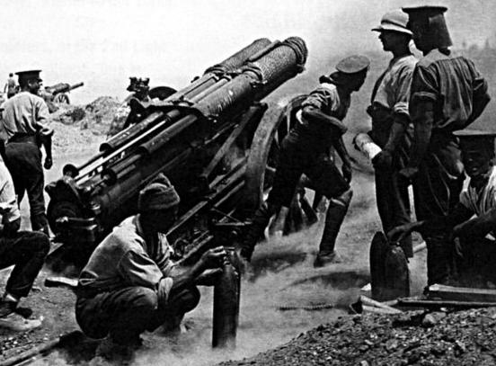
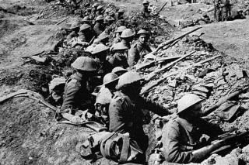
Revolutionary wars
The situation in France continued to be tense during the following years.
Although Louis XVI had signed the Constitution, he entered into secret negotiations with the King of Prussia.
Rulers of other neighbouring countries too were worried by the developments in France and made plans to send troops to put down the events that had been taking place there since the summer of 1789.

Slide 54
Before this could happen, the National Assembly voted in April 1792 to declare war against Prussia and Austria.
The French army sang Marseillaise, song composed by the poet Roget de L’Isle.
The Marseillaise is now the national anthem of France.
The revolutionary wars again brought losses and economic difficulties to the people.

Slide 55
While the men were away fighting at the front, women were left to cope with the tasks of earning a living and looking after their families.
Large sections of the population were convinced that the revolution had to be carried further, as the Constitution of 1791 gave political rights only to the richer sections of society.

Slide 56
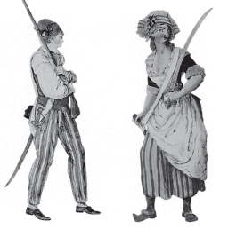
Political clubs became an important rallying point for people who wished to discuss government policies and plan their own forms of action.
The most successful of these clubs was that of the Jacobins, which got its name from the former convent of St Jacob in Paris.

Slide 57
French Republic
In the summer of 1792 the Jacobins planned an insurrection of a large number of Parisians who were angered by the short supplies and high prices of food.
On the morning of August 10 they stormed the Palace of the Tuileries, massacred the king’s guards and held the king himself as hostage for several hours.

Slide 58
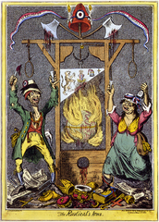
Later the Assembly voted to imprison the royal family.
Elections were held. From now on all men of 21 years and above, regardless of wealth, got the right to vote.
The newly elected assembly was called the Convention.

Slide 59
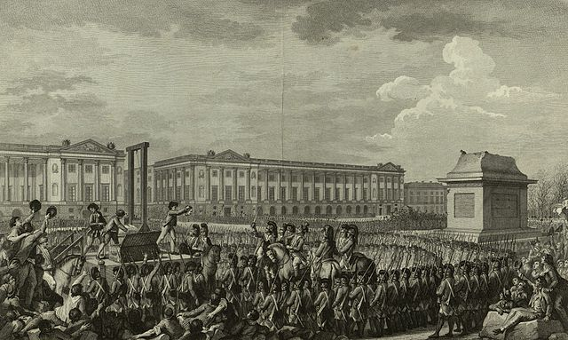
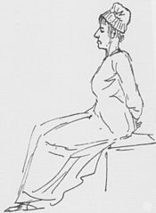
On 21 September 1792 it abolished the monarchy and declared France a republic.
On 21 January 1793 Louis XVI was executed publicly at the Place de la Concorde on the charge of treason.
The queen Marie Antoinette met with the same fate shortly after.

Slide 60
Robespierre’s state policy
Robespierre’s government issued laws placing a maximum ceiling on wages and prices.
Meat and bread were rationed.
Peasants were forced to transport their grain to the cities and sell it at prices fixed by the government.
The use of more expensive white flour was forbidden.
All citizens were required to eat the bread made of wholewheat.

Slide 61
Equality was also sought to be practised through forms of speech and address.
Instead of the traditional Sir and Madam, all French men and women were henceforth Citoyen and Citoyenne (Citizen).
Churches were shut down and their buildings converted into barracks or offices.

Slide 62
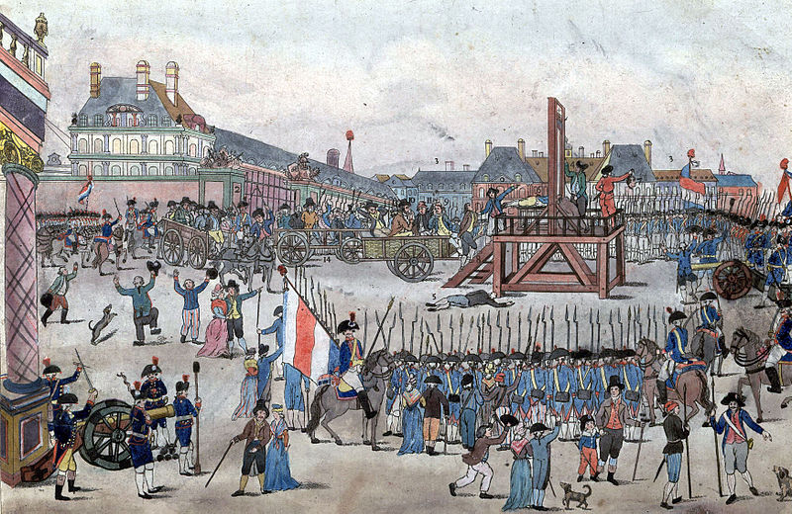
The Reign of Terror
The period from 1793 to 1794 is referred to as the Reign of Terror.
Robespierre followed a policy of severe control and punishment.
All those whom he saw as being ‘enemies’ of the republic – ex-nobles and clergy, members of other political parties, even members of his own party who did not agree with his methods – were arrested, imprisoned and then tried by a revolutionary tribunal.

Slide 63
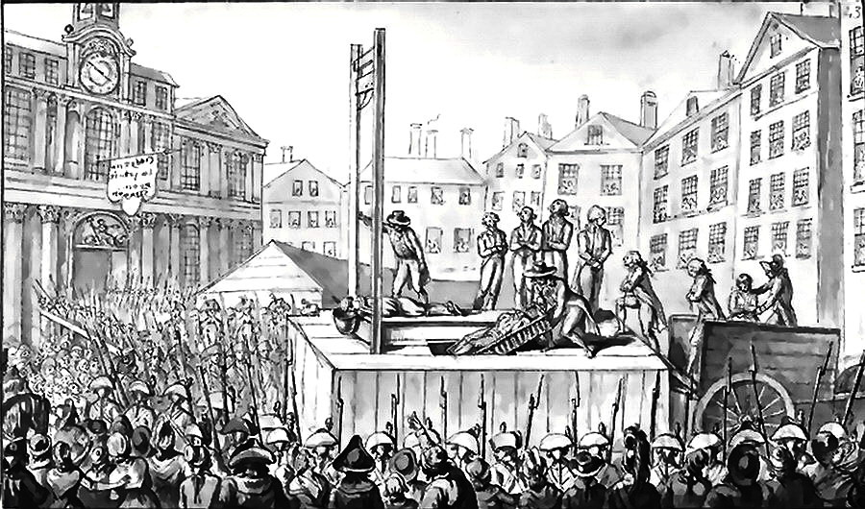
If the court found them ‘guilty’ they were guillotined (The guillotine is a device consisting of two poles and a blade with which a person is beheaded.
It was named after Dr Guillotin who invented it).
Robespierre pursued his policies so relentlessly that even his supporters began to demand moderation.
Finally, Robespierre was convicted by a court in July 1794, arrested and on the next day sent to the guillotine.

Slide 64
Directory Rules
France
The fall of the Jacobin government allowed the wealthier middle classes to seize power.
A new constitution was introduced which denied the vote to non-propertied sections of society.
It provided for two elected legislative councils.
These then appointed a Directory, an executive made up of five members.

Slide 65
This was meant as a safeguard against the concentration of power in a one-man executive as under the Jacobins.
However, the Directors often clashed with the legislative councils, who then sought to dismiss them.
The political instability of the Directory paved the way for the rise of a military dictator, Napoleon Bonaparte.

Slide 66
Through all these changes in the form of government, the ideals of freedom, of equality before the law and of fraternity remained inspiring ideals that motivated political movements in France and the rest of Europe during the following century.

Slide 67
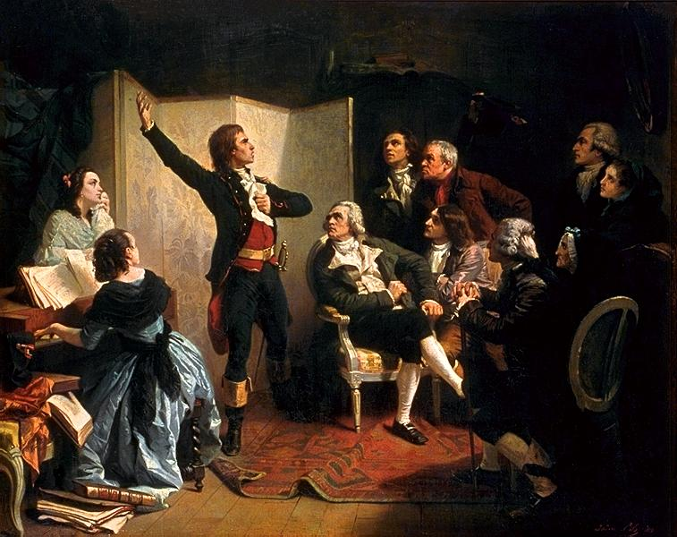
France under Dictatorship
An Army chief under king Louis XVI namely, Napoleon Bonaparte crowned himself Emperor of France In 1804.
He set out to conquer neighbouring European countries, dispossessing dynasties and creating kingdoms where he placed members of his family.

Slide 68
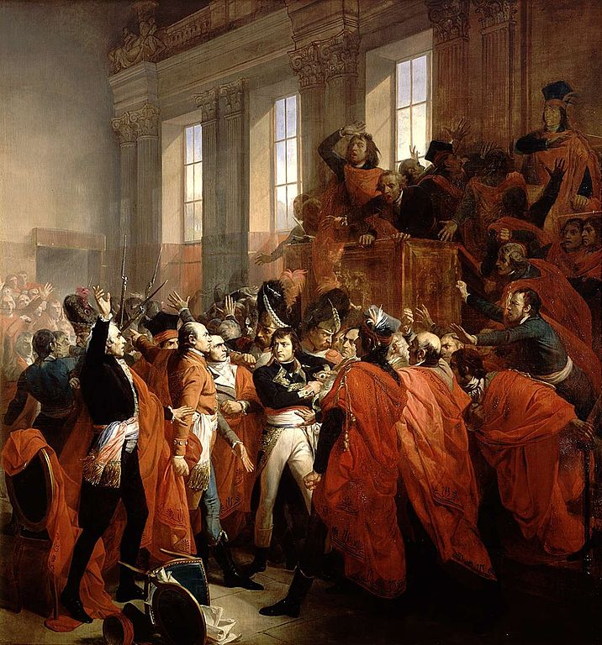
Napoleon saw his role as a moderniser of Europe.
He introduced many laws such as the protection of private property and a uniform system of weights and measures provided by the decimal system.

Slide 69
Initially, many saw Napoleon as a liberator who would bring freedom for the people.
But soon the Napoleonic armies came to be viewed everywhere as an invading force.
He was finally defeated at Waterloo in 1815.
Many of his measures that carried the revolutionary ideas of liberty and modern laws to other parts of Europe had an impact on people long after Napoleon had left.

Slide 70
Consequences
Consequences
Consequences
Consequences
Consequences

Slide 71

Consequences
One important law that came into effect soon after the storming of the Bastille in the summer of 1789 was the abolition of censorship.
Freedom of the press also meant that opposing views of events could be expressed.
the Declaration of the Rights of Man and Citizen proclaimed freedom of speech and expression to be a natural right.

Slide 72
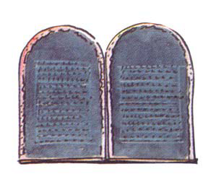
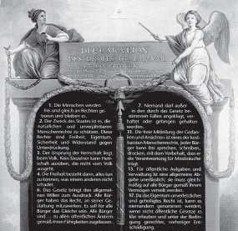
The ideas of liberty and democratic rights were the most important legacy of the French Revolution.
These spread from France to the rest of Europe during the nineteenth century, where feudal systems were abolished.
Colonised peoples reworked the idea of freedom from bondage into their movements to create a sovereign nation state.

Slide 73
Tipu Sultan and Rammohan Roy are two examples of individuals who responded to the ideas coming from revolutionary France.

Slide 74
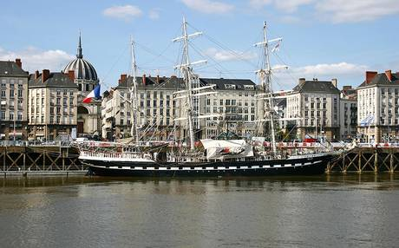
Abolition of slavery
The slave trade began in the seventeenth century.
French merchants sailed from the ports of Bordeaux or Nantes to
the African coast, where they bought slaves from local chieftains.
In Caribbean. they were sold to plantation owners.

Slide 75
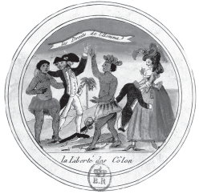
Throughout the eighteenth century there was little criticism of slavery in France.
The National Assembly held long debates it.
But it did not pass any laws, fearing opposition from businessmen whose incomes depended on the slave trade.

Slide 76
One of the most revolutionary social reforms of the Jacobin regime was the abolition of slavery in the French colonies in 1794.
This, however, turned out to be a short-term measure: ten years later, Napoleon reintroduced slavery.
Slavery was finally abolished in French colonies in 1848.

Slide 77

Role of women
From the very beginning women were active participants in the events which brought about so many important changes in French society.
They hoped that their involvement would pressurize the revolutionary govt to introduce measures to improve their lives.

Slide 78

In order to discuss and voice their interest’s women started their own sixty political clubs and newspapers.
From the very beginning they demanded the right to vote to be elected to the assembly and to hold political offices.
As a result, the govt made schooling compulsory for all girls.

Slide 79

Their fathers could no longer force them into marriages against their will.
Divorce was made legal.
It was finally in 1946 that women in France won the right to vote.

